Slide 1
R&T&M Webshop
(Kardos Máté,Kéri Tamás,Kósa Róbert)

Slide 2
Introduction
The idea was to create a webshop that gathers fashionable and trendy products from major brands and offers them at better prices than other shops
Our target audience includes all consumers who want to keep up with fashion but prefer not to pay the full price for individual clothing items.
Our store aims to provide these customers with a more affordable and budget-friendly option.

Slide 3
Team
Róbert: Robert was responsible for the backend functionality of the website.
Tamás: Tamás worked on the design and the frontend functionality of the website.
Máté: Máté was the project manager, and he handled the database and the presentation.

Slide 4
Communication
Our communication was effective, both in-person and through Discord and Messenger.
We shared code via GitHub and tracked work-related tasks and plans using Jira.

Slide 5
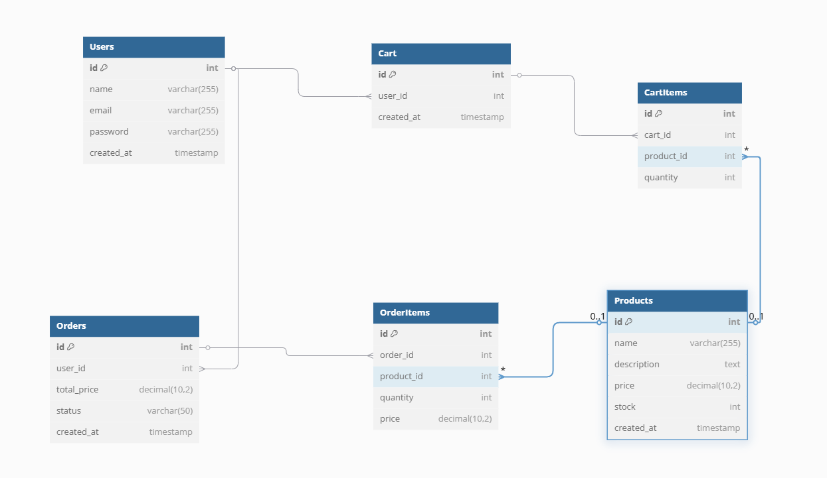
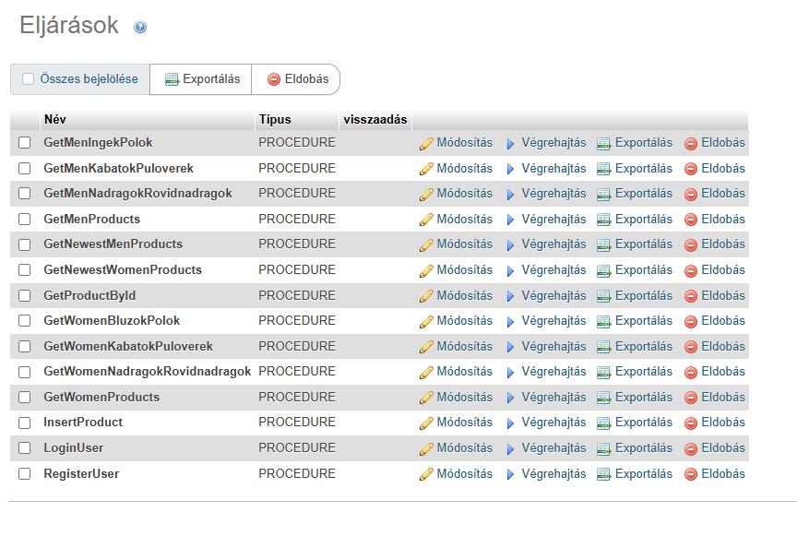
Database
Procedures
Database design

Slide 6
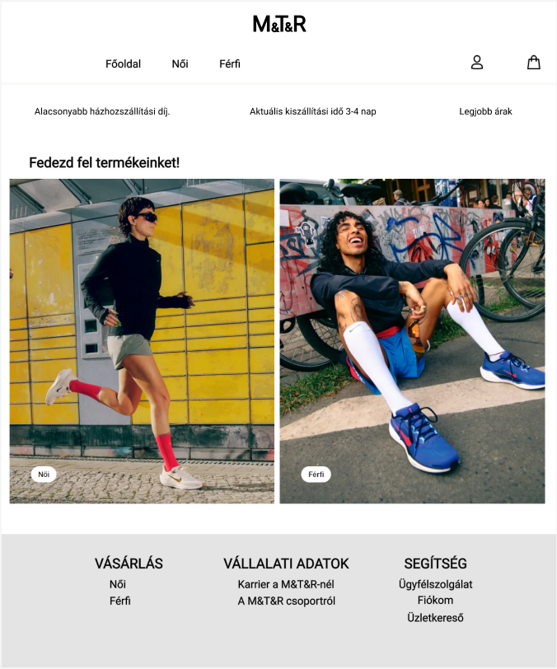

Index
Cart – View and manage selected products before checkout.
Account – Access personal details and settings.
Men’s & Women’s Section – Browse products categorized by gender for easier navigation.

Slide 7
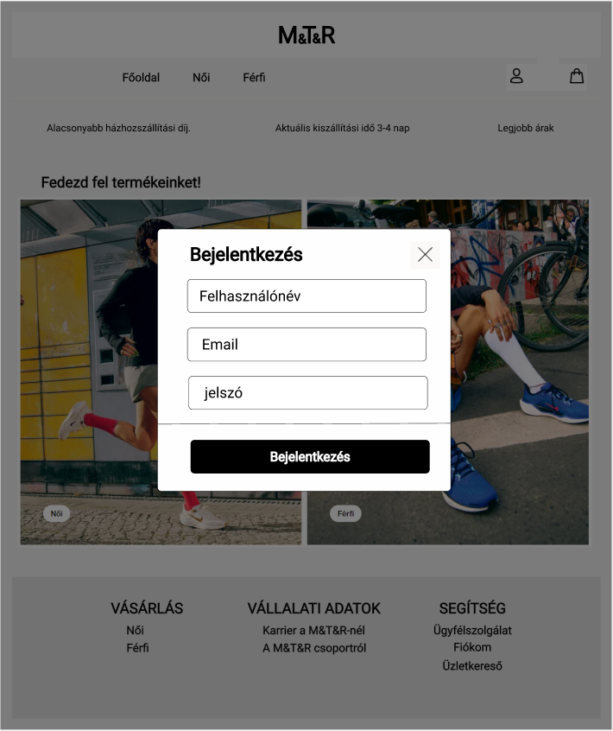
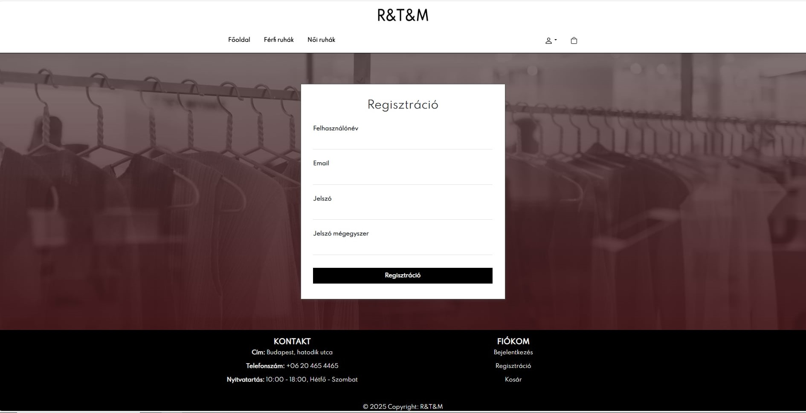
Login
Registration – A simple and quick process by providing name, email address, and password.
Login – Registered users can log into their account using the provided credentials.
Security – Data protection is ensured by encrypted password storage.

Slide 8
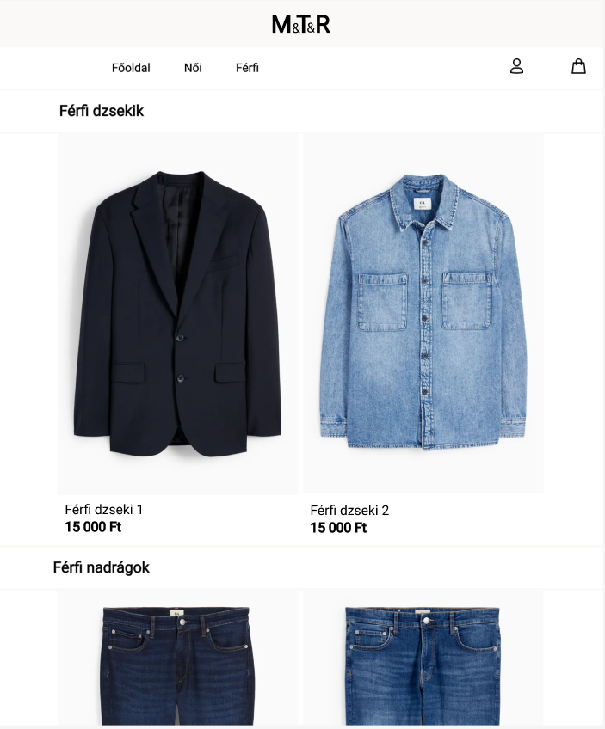
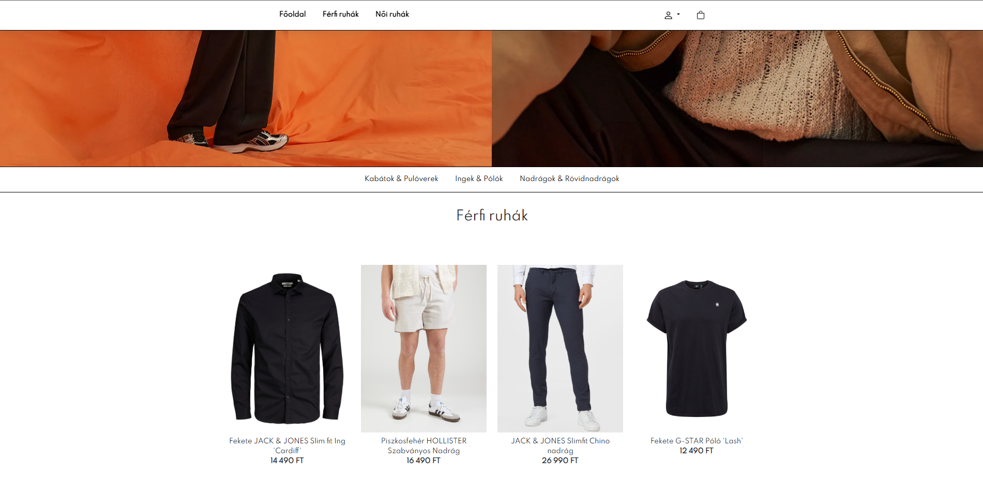
Products
Men's and Women's Categories – Products categorized by gender for easier navigation.
Products – A list of available clothing items with information and prices.

Slide 9
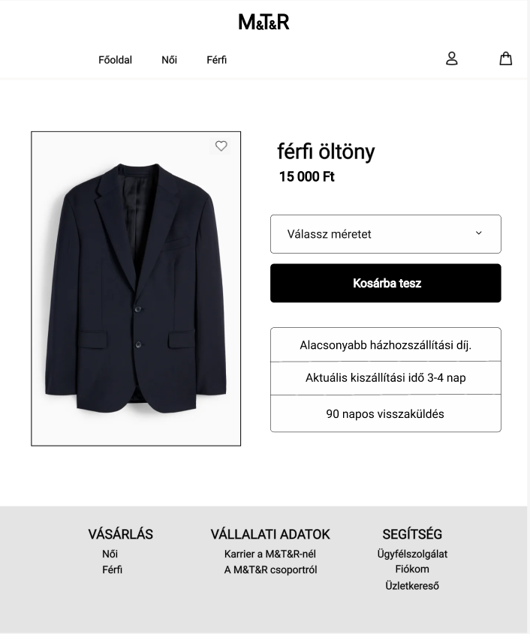
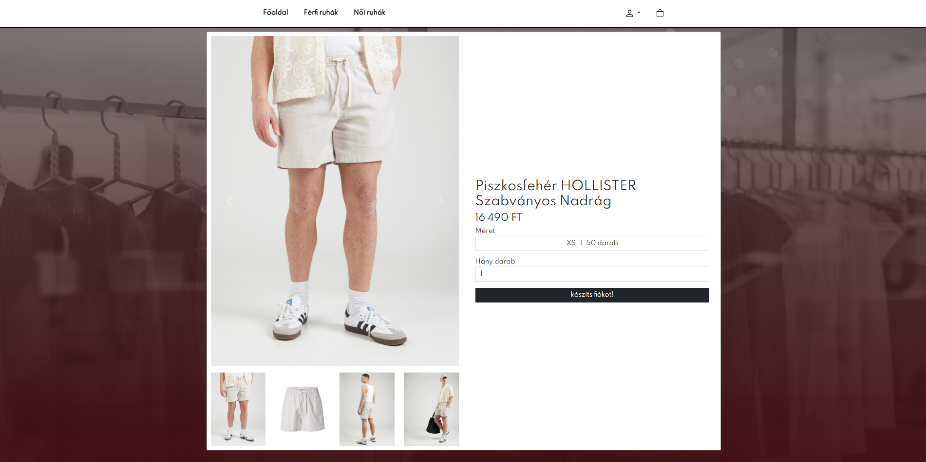
Products Page
Size Chart – Detailed measurements to help select the right size.
Quantity – Choose the number of products you want to purchase.
Available Stock – Displays the number of products currently in stock.

Slide 10
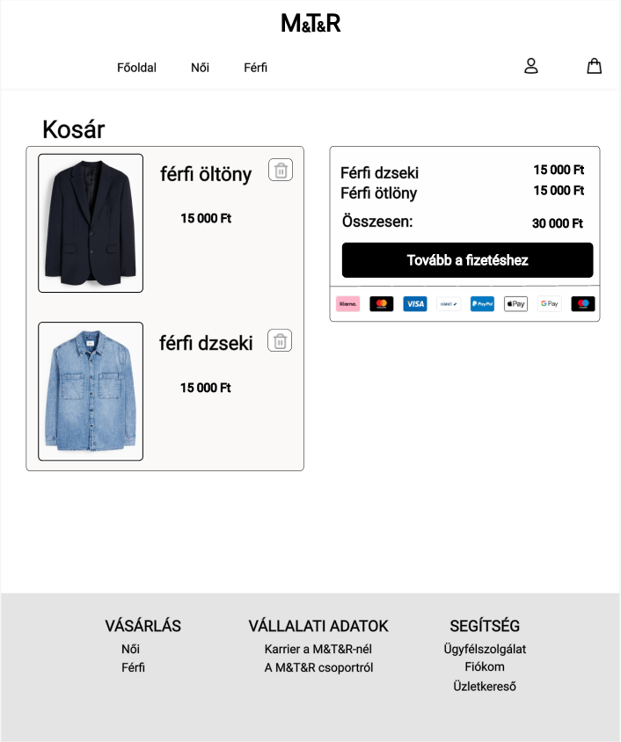
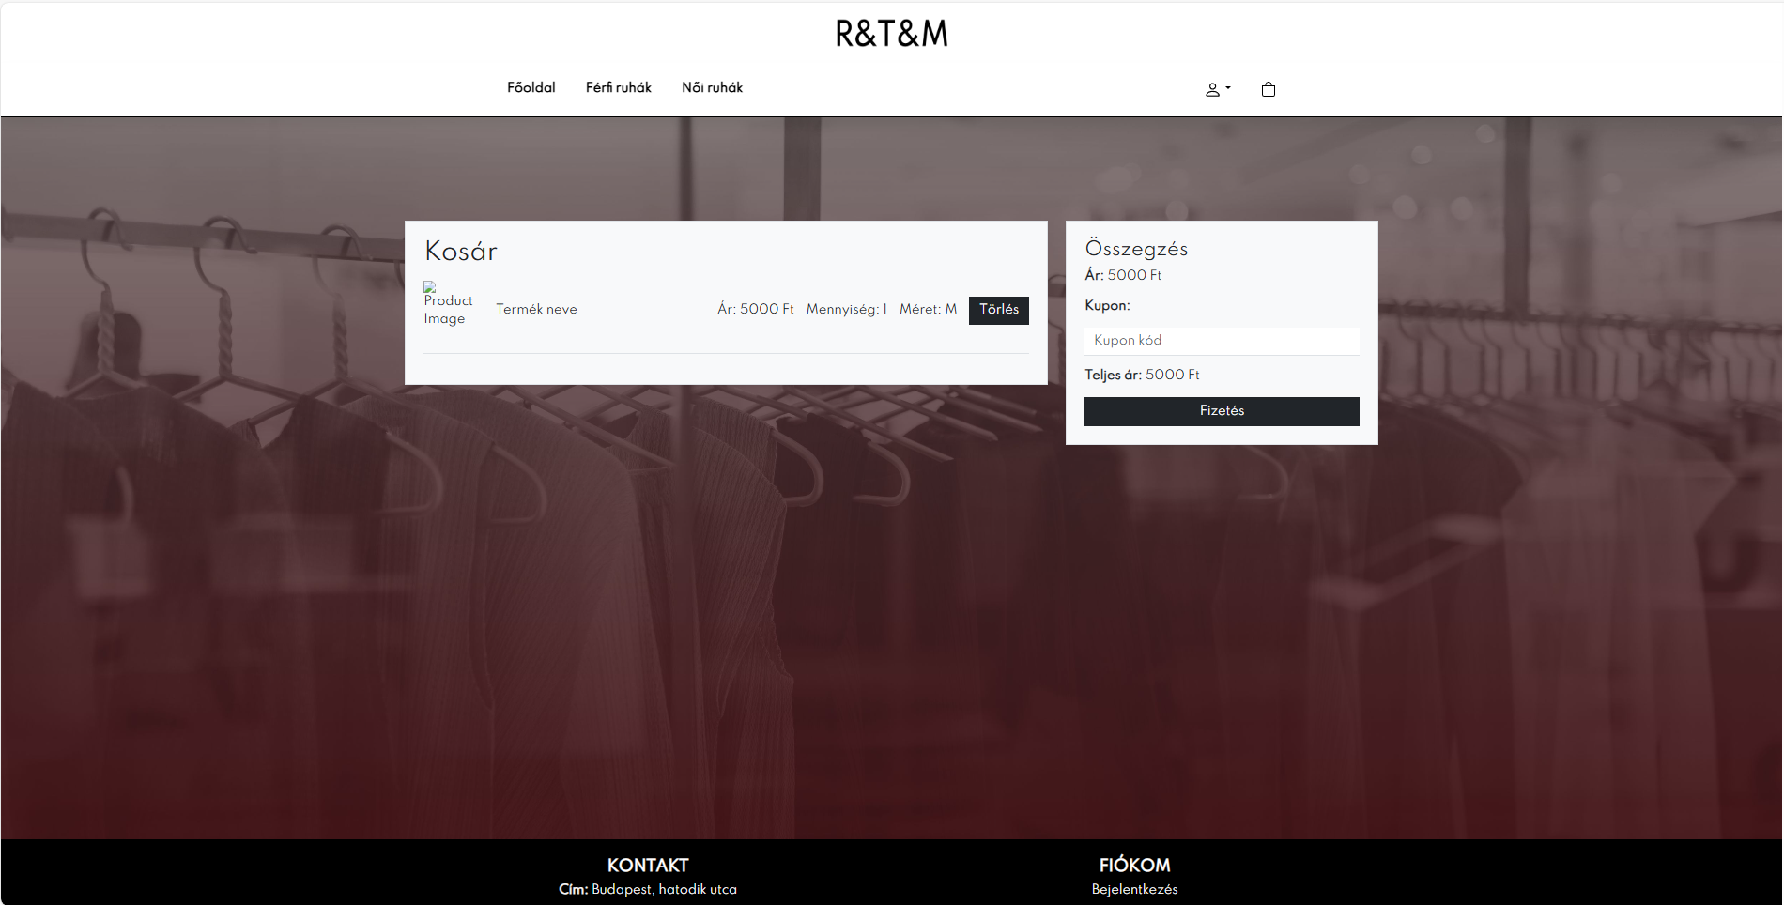
Cart
Cart Features: Products can be added and viewed during the purchase process.
It only stores the products as long as you stay on the site.
Payment: Currently, only cash on delivery and home delivery are available.

Slide 11
Next steps
Cart – The cart is currently not functional; we are working on fixing it.
Shipping – We need to implement the collection of shipping information.
Confirmation Emails – We aim to send confirmation emails for registration and orders.
Bug Fixes and Site Testing – Ongoing bug fixes and thorough testing of the website.

Slide 12
Thank you for your attention!

